Slide 1

Planning for future Ridership
SPARK
[CA-1: SB & PA]
ONG KIAN ENG A0052270U
WANG BOCHEN A0198493J
XIAO JINTING A0198422Y
XU SHENG A0198450X
YANG XIAORUI A0198456L

Slide 2

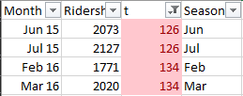
Data Preparation StepS
Check for missing values (NA)
Remove duplicates for column t (running sequence of month). Convert to running sequence
Convert Ridership and t to time series
Forecast period: 6 months Test period: Last 6 months before forecast (so that recent observations are taken into account in model building)
None found

Slide 3
Methods Used
Using forecastHybrid package (containing auto.arima, ets, thetam, nnetar, stlm, tbats, and snaive), only those methods with forecast closest to original time series were selected for combination (ensemble) model:
Auto-ARIMA
ETS
STLM
TBATS
Other forecasting methods such as Holt-Winter Exponential Smoothing, and user-generated ARIMA were also used.

Slide 4
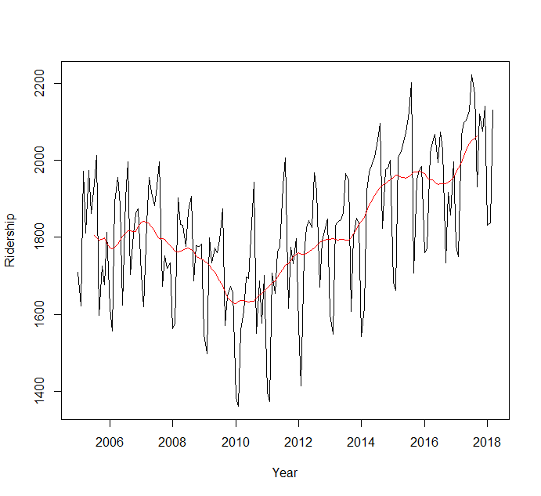
Current ridership trend
Increasing trend over past 8 years since 2010
Data from 2005 to 2009 were not used, considering that it was more than 8 years ago and its decreasing trend may affect the model.
Hence, only data since 2010 will be used for modelling as it is sufficiently long enough.

Slide 5
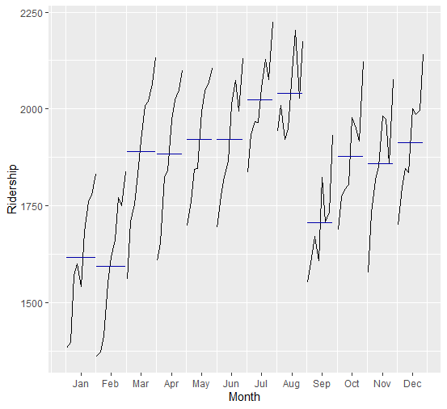
Variation across seasons (2010 – 2017)
Findings:
Overall increasing trend for each month year-on-year
High ridership from Jul to Aug (Aug is highest)
→ More trains to be deployed
Low ridership from Jan to Feb
→ Fewer trains to be deployed
High
Dec 2017
Jan 2017
Low
Dec 2010
Jan 2010
Ridership for each month across years
(Each line starts from 2010 on the left, to 2017 on the right)
Note: Similar seasonal variation was also observed from 2005 to 2010.

Slide 6
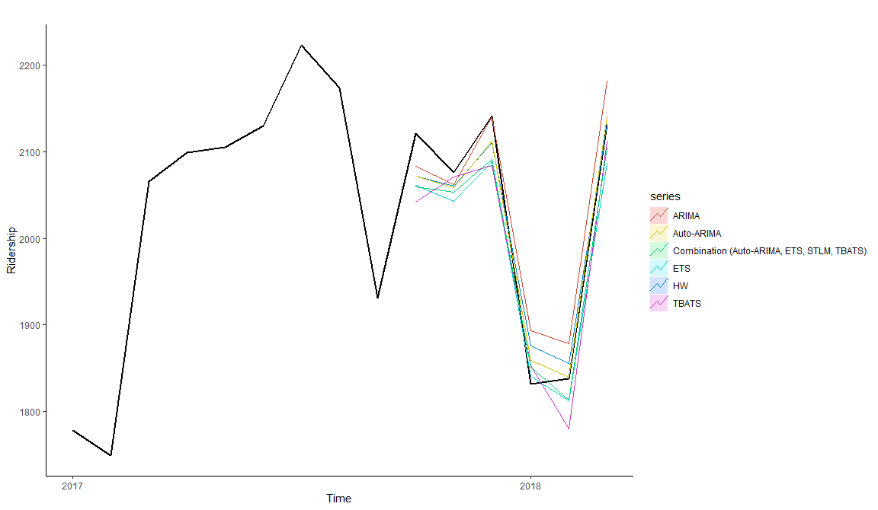
SELECTION OF MODEL (6 months forecast)
Auto-ARIMA was the best, hence it was used for forecasting.
Finding:
Auto-ARIMA was the best predictor close to original line, and has many errors that are the smallest across various measures of error, including MAPE which is a better metric that considered the overall percentage.
Type of errors
ME | mean error
RMSE | root mean squared error
MAE | mean absolute error
MPE | mean percentage error
MAPE | mean absolute percentage error
MASE | mean absolute scaled error
ACF1 | first-order autocorrelation coefficient
Theil’s U | uncertainty coefficient
Test Set Model | ME | RMSE | MAE | MPE | MAPE | MASE | ACF1 | Theil’s U
Holt-Winters | 5.74 | 31.3 | 26.3 | 0.195 | 1.32 | 0.339 | 0.132 | 0.128
Auto-ARIMA | 9.7 | 26.8 | 21.9 | 0.423 | 1.07 | 0.282 | 0.0923 | 0.0954
ETS | 34.7 | 41.3 | 37.4 | 1.65 | 1.8 | 0.482 | -0.173 | 0.188
ARIMA | -16.5 | 39.6 | 33.9 | -0.897 | 1.72 | 0.437 | 0.419 | 0.208
TBATS | 33 | 47.8 | 39.9 | 1.6 | 1.97 | 0.514 | -0.688 | 0.203
Combination | 27.8 | 37.5 | 34.1 | 1.32 | 1.66 | 0.44 | -0.307 | 0.156

Slide 7
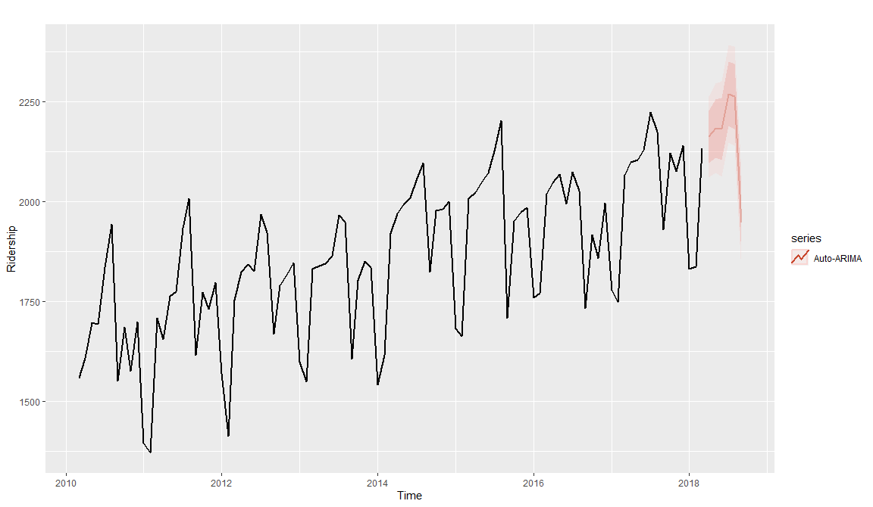
Forecasted average ridership
2018 | Forecasted average ridership (95% confidence)
Month | Lower band | Expected | Upper band
Apr | 2062 | 2162 | 2263
May | 2072 | 2184 | 2295
Jun | 2063 | 2182 | 2301
Jul | 2147 | 2270 | 2392
Aug | 2140 | 2264 | 2388
Sep | 1823 | 1948 | 2073
Usual drop in ridership from Aug to Sep

